Slide 1

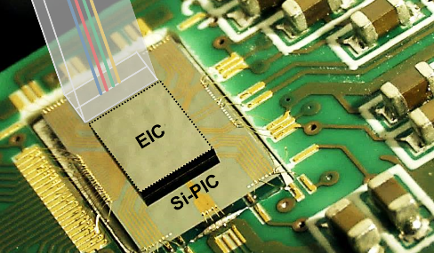
Silicon Photonics for high bandwidth communications

Slide 2
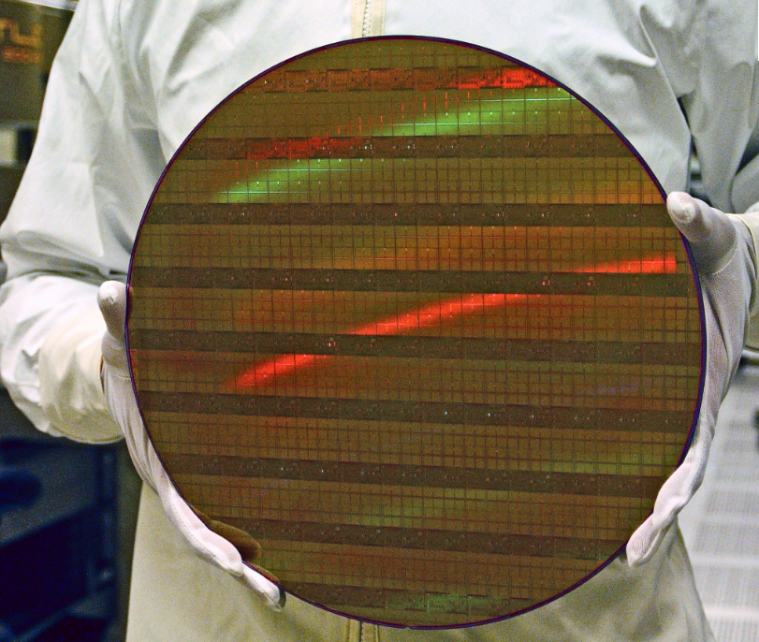
Why silicon photonics ?
Silicon photonics aims at integrating in the silicon microelectronic CMOS technology optical functions initially based on other technologies (InP, InGaAs, LiNbO3, SiO2, …)
Need for integration is driven by:
  Miniaturization: cost&size reduction, power consumption
  Increased complexity and functionnality
300mm Si wafer

Slide 3
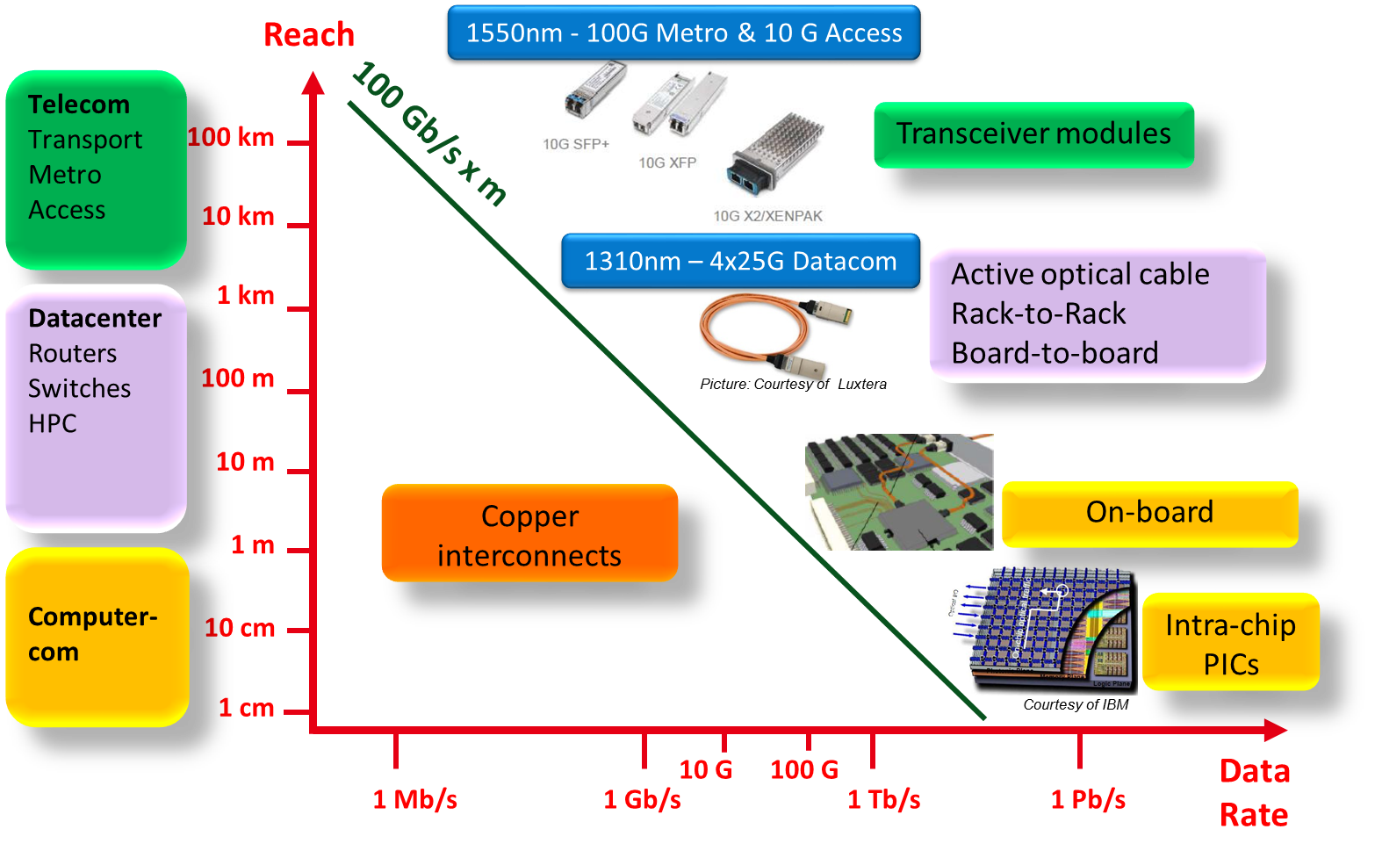
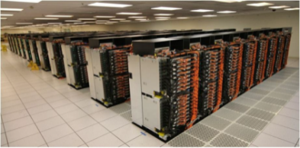
Main Silicon Photonics ApPlications
1550 nm – > 100G → 400G Metro & 10G Access
1310 nm – 100G →400G Datacom
Datacenter
Routers
Switches
HPC
Rack-to-Rack
Board-to-Board
On-board
1310 nm – > 1Tb/s Computercom

Slide 4
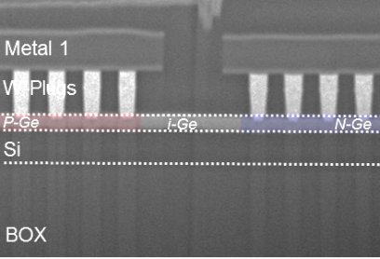
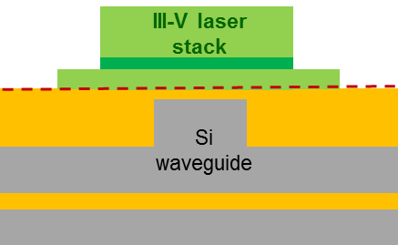
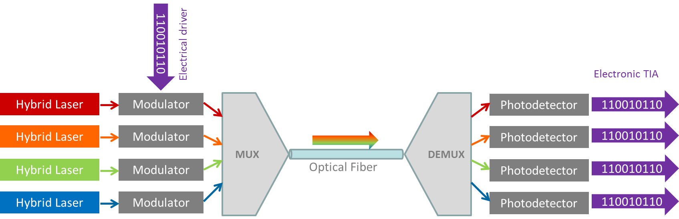
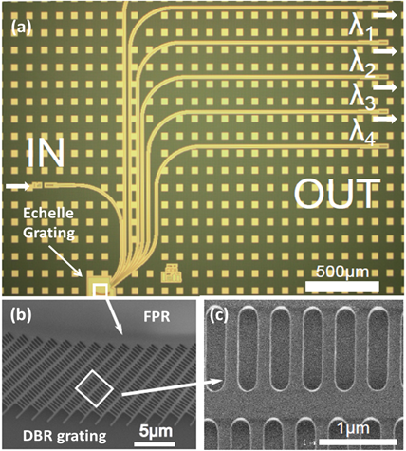
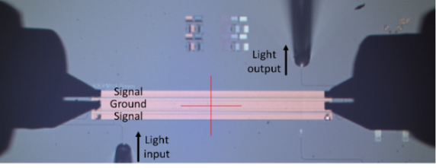
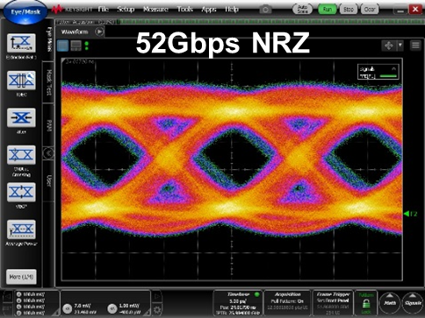
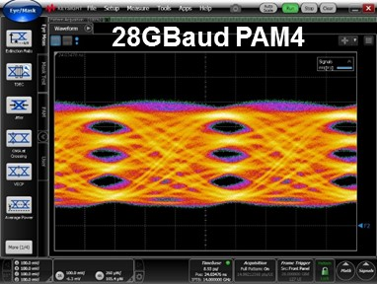
Si Photonics Building blocks at 50 Gb/s
Si or SiN
(AWG or echelle design)
1D and 2D grating couplers
Edge couplers

Slide 5
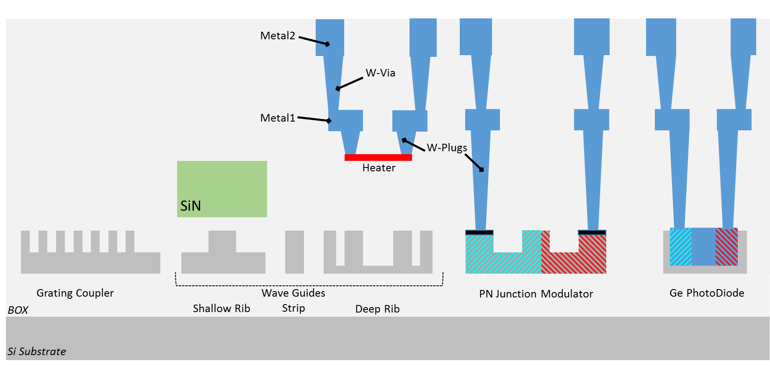
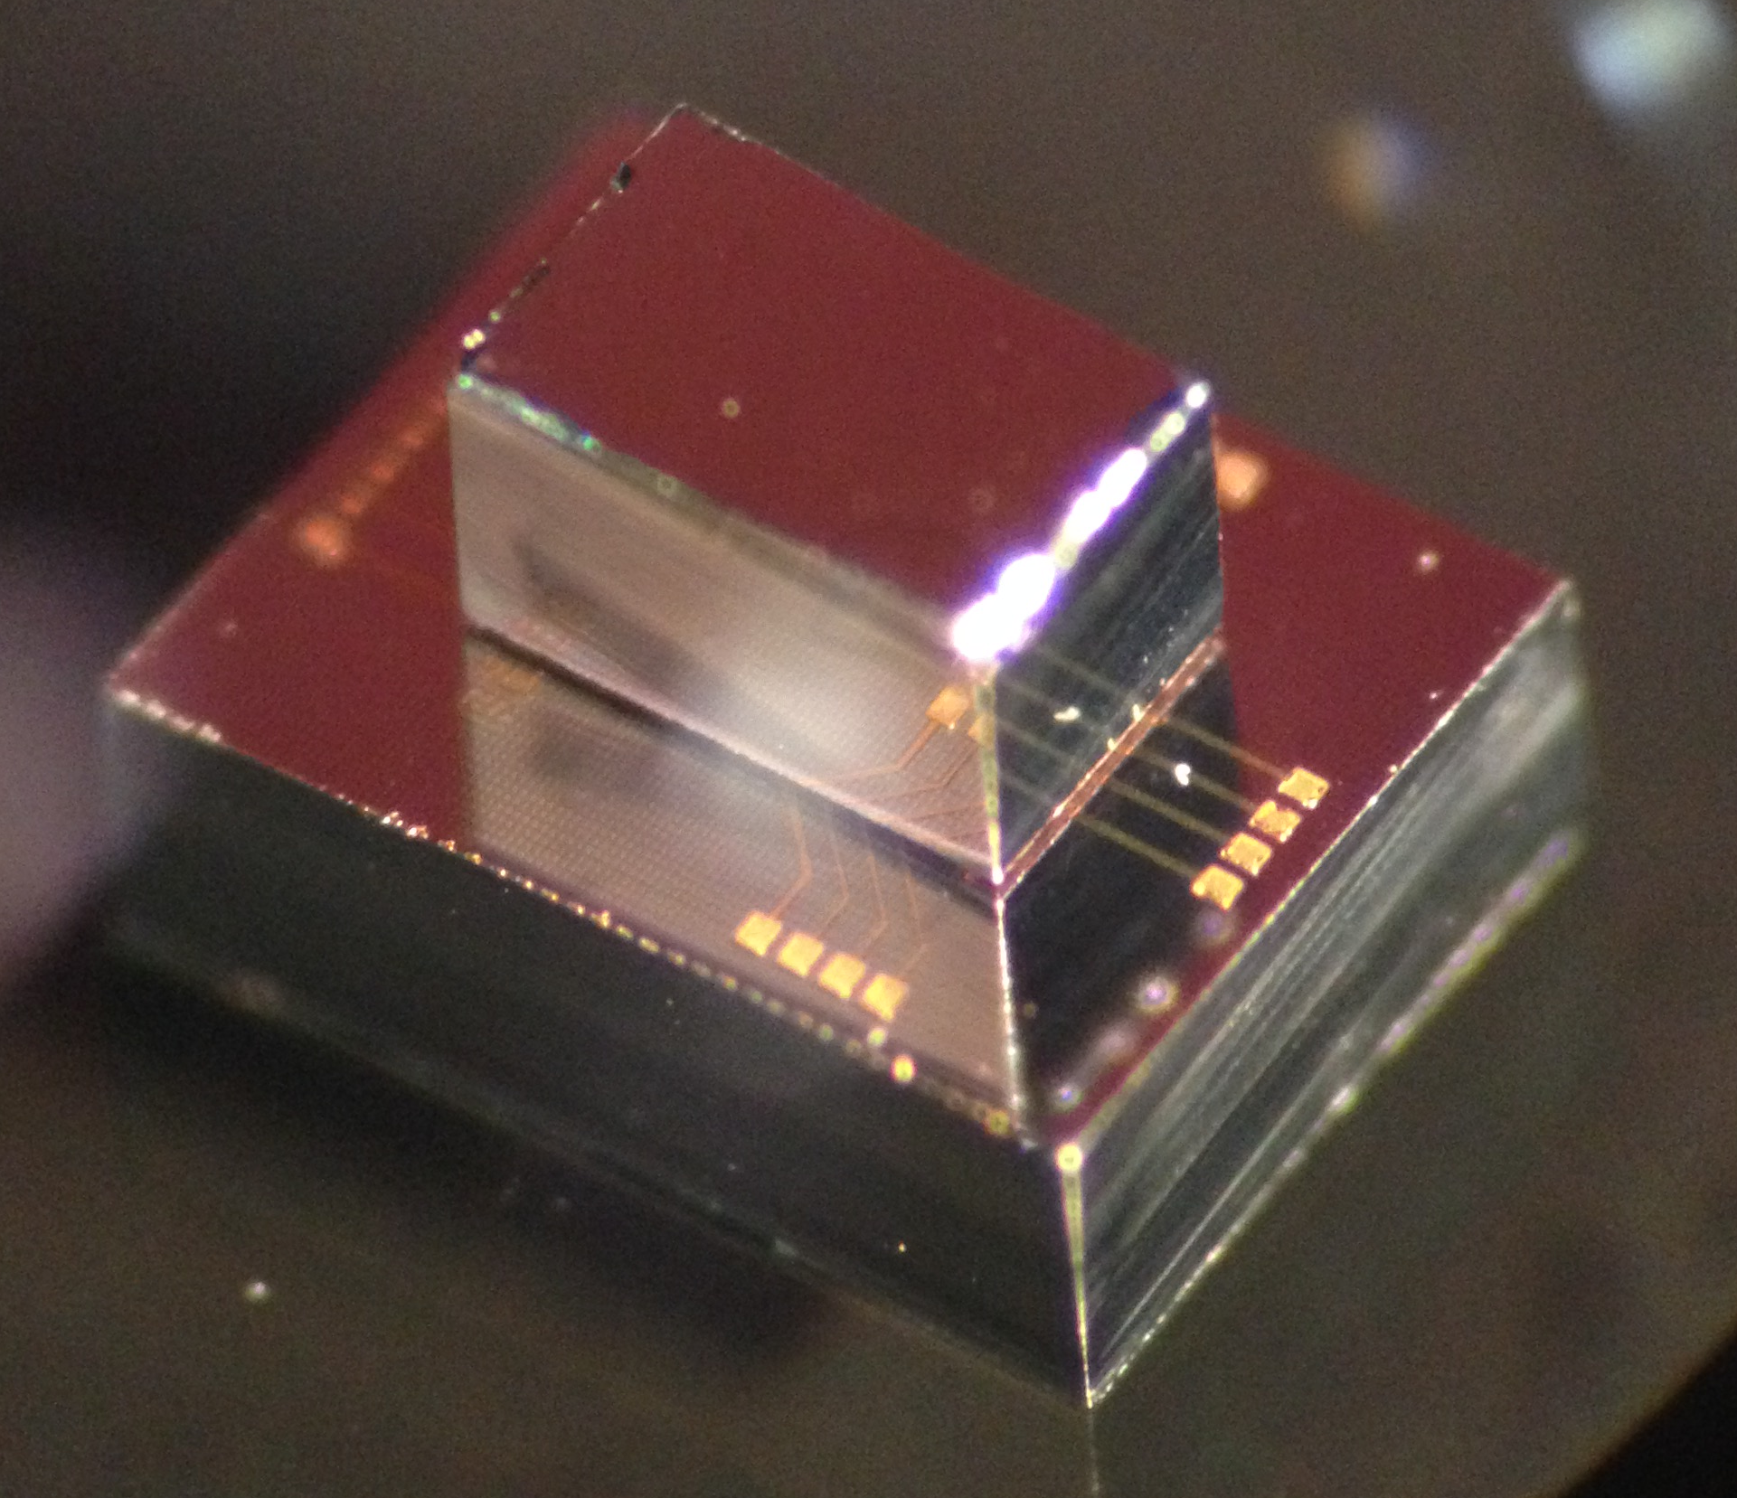
Technology key process features
Low parasitics 3D Photonic/Electronic Integration
PDKs available (Cadence, Phoenix…)
Complete library with Models, Circuit simulation, Layout, Verification, Layout finishing
3D integration with electronics
Compatibility with 300 mm industrial foundry

Slide 6
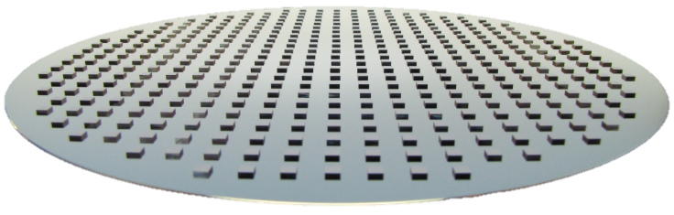
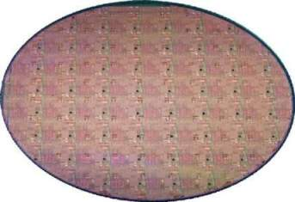
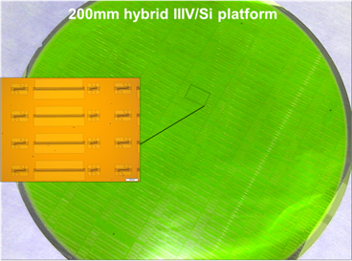
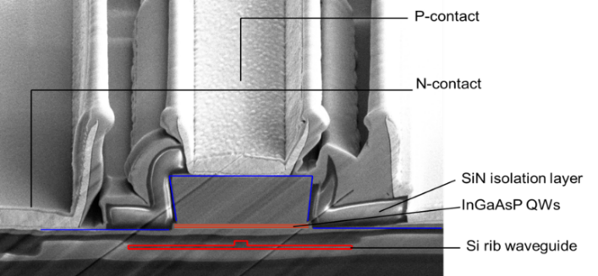
hETEROGENEOUS III-V INTEGRATION: Lasers, modulators, optical amplifiers
Growth of the III-V wafers
2’’, 3’’, 4’’
III-V die or wafer bonding on processed SOI + InP substrate removal
Processing of SOI wafers 200/300 mm
III-V Processing

Slide 7

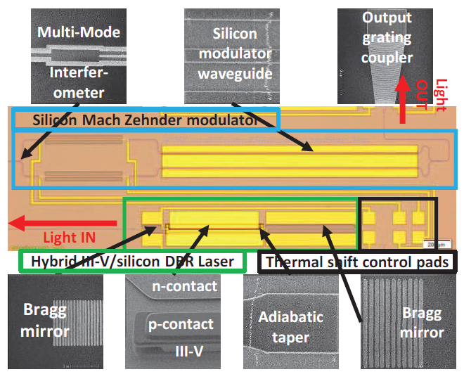
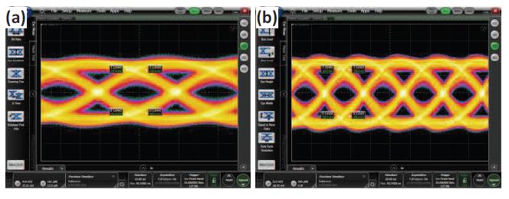
Fully integrated transmitter @ 1.3 µm for DATACOM applications
Co-integration of hybrid III-V/Si DBR laser + Si Mach-Zehnder modulator
  2.5 Vpp on each arm of the MZM (both biased @ 1.25V)
  Laser wavelength : 1303.5 nm
  Data rate : 25 Gb/s with ER=4.7 dB
25 Gb/s eye diagrams
Back-to-back
Transmission over 10 km

Slide 8

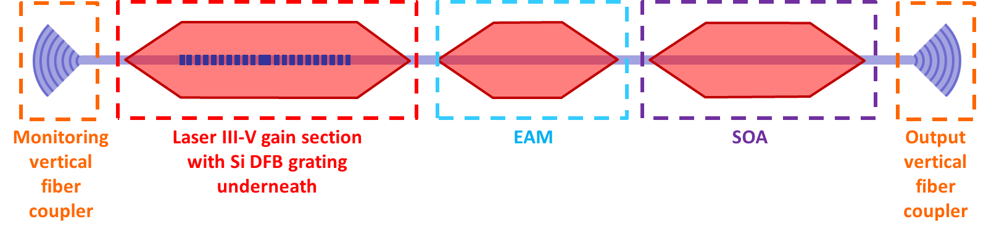
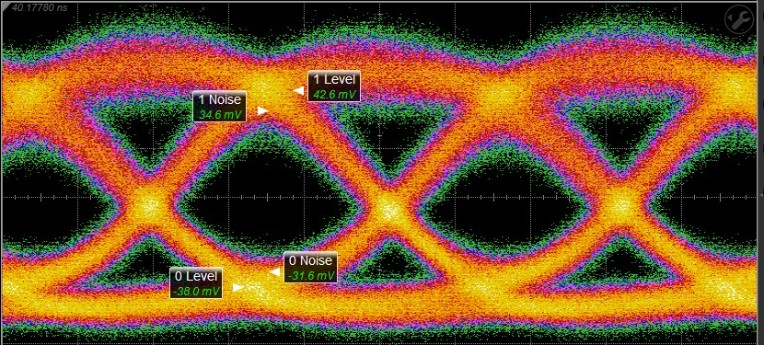
DFB laser integrated with EAM modulator
Wafer bonding with single epitaxial stack
32 Gb/s – optimal predistorsion – ER=6.7dB
Laser 150mA, EAM -0,6V±0,9V, SOA 90mA, PD 32GHz BW

Slide 9
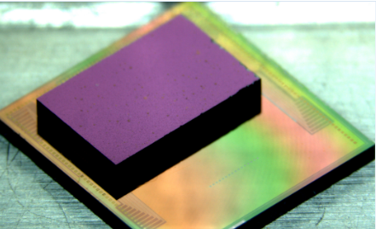
Reconfigurable Silicon Photonics Switch Matrix
Next Gen ROADM: 4 directions, 12 wavelengths
384 optical switches → more than 1000 integrated photonic components, each individually electronically controlled
Flip chip assembly : 2091 microbumps

Slide 10
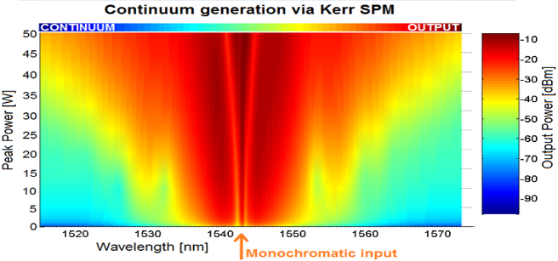
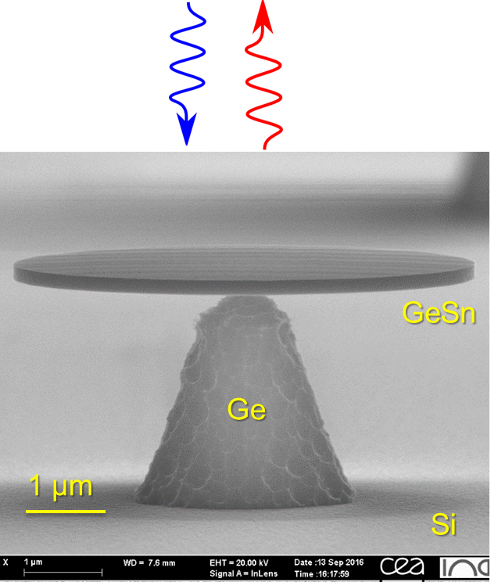
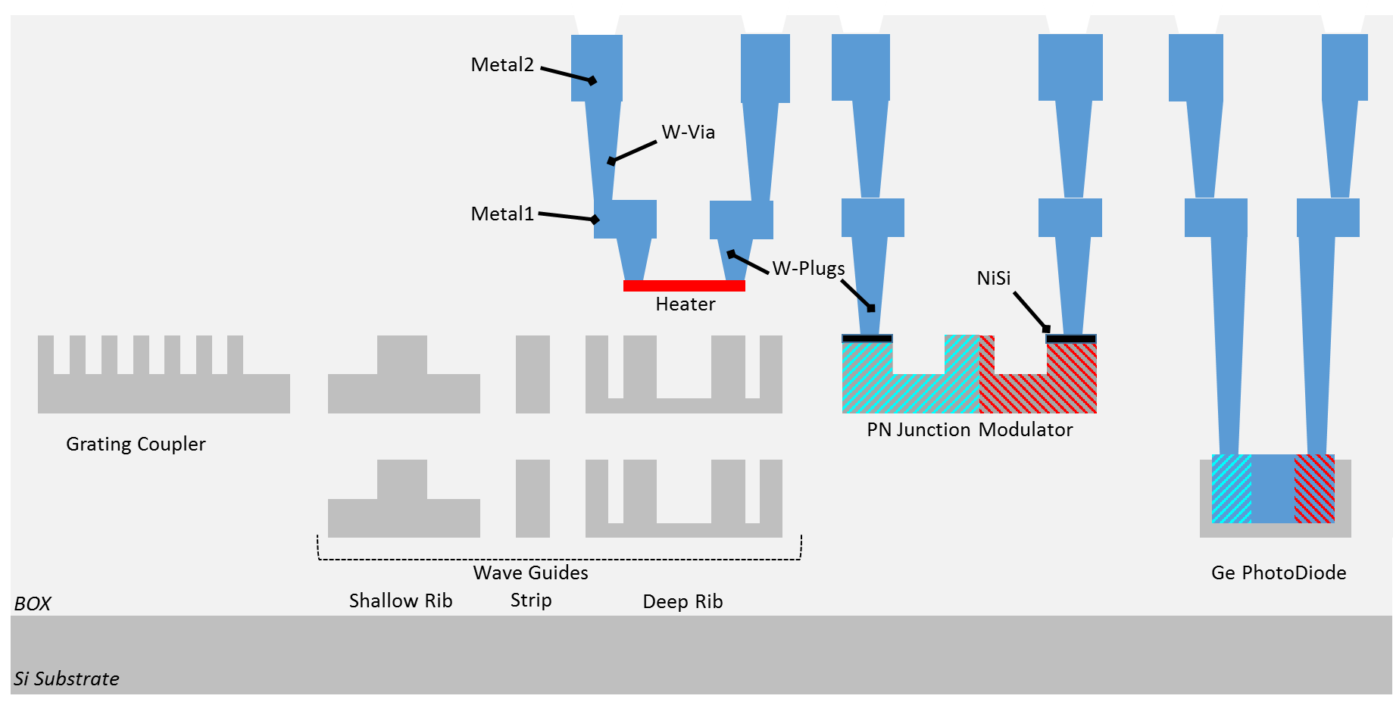
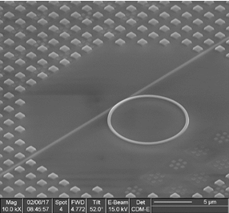
What’s next : upgrade of the technology platform
Non linear optics: Broadband sources, switching, frequency conversion, …
Germanium-based lasers: laser effect demonstrated in GeSn microdisks
Photonic layer stacking

Slide 11
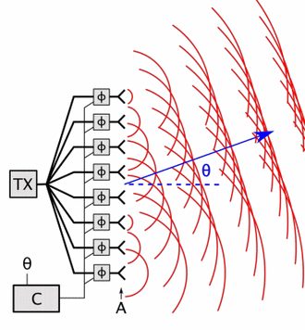
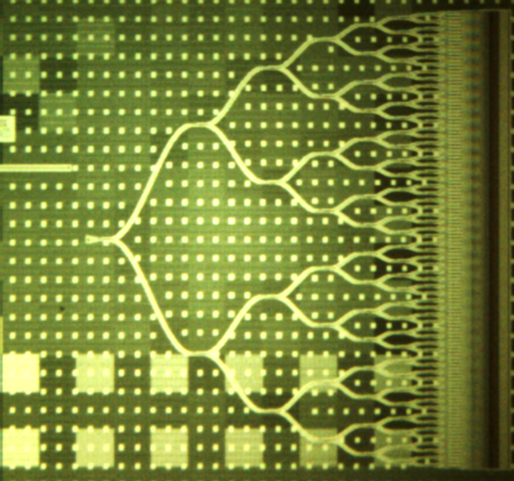
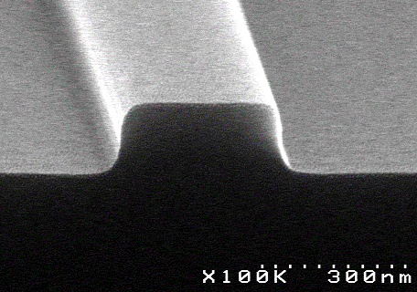
What’s next : new applications
Integrated Lidar
Quantum technologies, optical computing
→ On going work to develop ultra low loss optical waveguides, integrated single photon detectors, …
Chemical Sensing in the visible and Mid IR range
→ next talk

Slide 12
Conclusion / Take away
Complete platform available: design, fab, test, packaging
Key features: III-V/Si, 3D integration, new functionnalities
Silicon Photonics for high bandwidth communications
not only
… but also for many application fields

